Slide 1

CompTIA Security+ Certification - SYO-601 Exam Training

Slide 2


Domain 2: Architecture and Design

Slide 3
Summarizing Basic Cryptographic Concepts

Slide 4


Learning Objectives
By the end of this lesson, you will be able to:
Evaluate cryptographic ciphers
Analyze cryptographic modes of operation
Outline the weakness of cryptography
Illustrate cryptographic technologies

Slide 5
Compare and Contrast Cryptographic Ciphers

Slide 6

Cryptographic Concepts
Cryptography is the skill of encrypting data in order to make it secure. The different terms in cryptography are listed below:
Plaintext (or cleartext) is a message that is not encrypted.
Ciphertext is a message that has been encrypted.
Cryptanalysis involves cracking
of cryptographic systems.
Cipher is the process by which a message is encrypted and decrypted.

Slide 7
Cryptographic Concepts
When describing threats against encryption systems, it is a common practice to refer to the various actors involved in the attack as a cast of characters. The central characters are as follows:
Bob: The message's
intended recipient
Alice: The sender of an authentic message
Mallory: An adversary attempting to subvert the message in some way

Slide 8
Cryptographic Concepts
There are three distinct types of cryptographic algorithms, each of which plays a unique role in ensuring the security properties. They are:
Type 01
Symmetric and Asymmetric ciphers
Hashing Algorithms
Type 02

Slide 9

Hashing Algorithms
Hashing algorithms are the simplest cryptographic algorithms. Using plain text with variable length, it generates fixed length output commonly known as hash string.
The function is designed in such a way that the plaintext data cannot be recovered from the digest (one-way) and that different inputs are unlikely to produce the same output.

Slide 10
Hashing Algorithms
The most widely used hash algorithms are:
Secure Hash Algorithm (SHA)
Message Direct Algorithm -5 (MD5)
Is a Non-vulnerable algorithm
SHA 256 is the mostly used variant (adopted version of SHA)
Generates 128-bit digest
Is less secure compared to other algorithms

Slide 11

Hashing Algorithms
For instance, Bob and Alice can compare the password values in the following manner:
Bob already has a digest of Alice's plaintext password calculated. Bob is unable to decrypt the hash plaintext password value.
When Alice needs to authenticate with Bob, she types her password into a text editor, converts it to a hash, and sends the hash to Bob.
Bob compares Alice's digest to the hash value that he has stored on his computer.

Slide 12
Hashing Algorithms
Along with comparing password values, a file's hash can be used to verify the file's integrity following the transfer.
Alice applies a hash function to
her product's setup.exe file.
1
Bob downloads the setup.exe file and copies the digest to his computer.
Bob computes a hash, but it does not match, indicating that the file has been modified.
2
4
3
Bob compares the downloaded setup.exe file to the reference value published by Alice using the same hash function.

Slide 13













Hashing Algorithms
Bob and Alice can compare the password values in the following manner:
Alice
1
Alice publishes a file and reference hash value
Bob
2
Bob downloads the file and records the reference hash value
Bob computes a hash
###
###
3
and compares it to the reference value
“HelloWorld”
(File)
“###”
(Hash)
“HelloWorld”
“###”
Mallory injects a malicious download, but cannot change the reference hash value
Bob computes a hash, but it
5 does not match the reference, so he rejects the file
Mallory
4
###
“HelloWorld”
“HelloWorld”
“?#!”

Slide 14
Encryption Ciphers and Keys
Features of encryption ciphers and keys include:
Hashing is not encryption, and the process is not reversible.
1
2
Encryption uses a reversible process based on a secret.
Key protection is easier for the algorithm.
6
Process should be complex to unravel without the secret like substitution and transposition.
3
Key offers security of plain text.
5
4
It cannot keep the cipher/algorithm as the secret.

Slide 15
Substitution Technique
In substitution ciphers plaintext, letters are replaced with another letter or symbol.
Example
Let’s have a look on ancient but effective Caesar Cipher, used by Caesar to
send letter to Juliet.
Message
Dear Juliet Simplilearn has a course
Crypt/De-crypt Key: Letter + 2
Cipher: Fgct Lwnkgv Ukornkngctp jcu c eqwtug

Slide 16
Substitution Technique
This uses rail fence method, where plaintext is aligned as diagonal formation and count as row sequence.
Example
Sample Plaintext is “ Simplilearn Course”
Even letters are arranged in row 2 and odd letters in row 1.
S m l l a n o r e p i e r C u s
i
Encrypt the message by arranging the letters in both the rows into a
single row as
SmllanoreipierCus

Slide 17






Symmetric Encryption
Symmetric encryption is a type of encryption in which the same secret key is used for both encryption and decryption. A symmetric cipher is one in which the same secret key is used for both encryption and decryption.
Alice
1
Alice and Bob share a symmetric key
Bob
Alice
Alice encrypts a file using the symmetric key
3
Alice sends the ciphertext to Bob
4
Bob decrypts the ciphertext using the same symmetric key
2
“HelloWorld”
(File)
“rWoeldloIH”
(Encrypted File)
“rWoeldloIH”
“rWoeldloIH”
“HelloWorld”

Slide 18



Symmetric Encryption
One key is used as secret key for encryption and decryption. Some of the features of symmetric encryption include:
Fast: suitable for bulk encryption of large amounts of data
Storage: difficult to store and distribute key
Confidentiality: only sender and recipient know the same key

Slide 19
Stream Ciphers
This is appropriate for encrypting communications where the message's total length is unknown. The plaintext is mixed with a separate randomly generated message derived from the key and an Initialization Vector (IV).
It encrypts and decrypts entire message one at a time.
An initialization vector (IV) is used.

Slide 20
Block Ciphers
In a block cipher, the plaintext is divided into smaller blocks. It also:
01
Creates data into equal size blocks and if required uses padding
02
Provides Advanced Encryption Standard (AES/AES256)

Slide 21
Key Length
The keyspace is the set of key values that can be used with a given cipher.
Longer the key bit length, larger the keyspace.
Strength of key for any given length varies between ciphers.
Range of key values is
the keyspace.

Slide 22
Asymmetric Encryption
Asymmetric ciphers are mainly used for authentication and non-repudiation.
Public key is used for encryption and Private key is used for decryption.
Public key is not derived from Private key and Private key must be kept secret.
Public key is easy to distribute.
Message size is limited to key size. Therefore, not suitable for large amounts of data.
Message size is used for small amounts of authentication data.

Slide 23











Asymmetric Encryption
The screenshot shows the server decrypting the key which is used to encrypt messages between server and client:
Alice
Bob
Bob generates an asymmetric key pair and keeps the private key secret
Bob
Bob publishes the public Key and Alice keeps a copy of it
2
1
Alice encrypts a message
using Bob’s public key
4
Alice sends the ciphertext to Bob
5
Bob decrypts the ciphertext using his private key
3
“HelloWorld”
(File)
“rWoeldloIH”
(Encrypted File)
“rWoeldloIH”
“rWoeldloIH”
“HelloWorld”
Mallory
Mallory
7
Mallory cannot use Bob’s public key
to reverse the encryption
Mallory sniffs the network Traffic and learns the public key value
and ciphertext
6

Slide 24

Public Key Cryptography Algorithms
Asymmetric encryption is referred to as public key cryptography. It includes RSA algorithm that:
1
Forms the basis of public key cryptography schemes
2
Uses Trapdoor function
3
Facilitates encryption with public key but needs private key to decrypt

Slide 25

Public Key Cryptography Algorithms
Algorithms for public key cryptography also has Elliptic Curve Cryptography (ECC) that:
1
Concerns about RSA being vulnerable to cryptanalysis
2
Forms a type of trapdoor function
3
Uses smaller keys to obtain same security

Slide 26
Cryptographic Modes of Operation

Slide 27
Digital Signatures
Digital signatures provide:
Public key cryptography with hashing
Integrity, authentication, non- repudiation
Digital Signature Algorithm
(DSA) with ECC cipher
RSA-based digital signatures

Slide 28











Digital Signatures
The screenshot shows the process of message authentication and integrity using digital signatures.
1
Hash of message encrypted with Alice's private key
2
Message with signature and public key
Bob
Alice
###
###
“HelloWorld”
(Message)
“###”
(Hash)
Encrypted Message with Signature
Bob decrypts the signature using Alice's public key and gets the reference hash value
“###”
3
Bob computes a hash and compares it to the reference value
4
###
“rWoeldloIH”
“###”

Slide 29













Digital Envelopes and Key Exchange
The only practical method for encrypting and decrypting large amounts of data is symmetric encryption, but it is difficult to distribute the secret key securely.
Alice
1
Alice obtains a copy of Bob's public key
Bob
2
Alice encrypts a file
using a symmetric key
“HelloWorld”
(File)
“rWoeldloIH”
(Encrypted File)
4
Alice sends the ciphertext and encrypted symmetric key to Bob
5
Bob decrypts the ciphertext
using the symmetric key
3
Alice encrypts the symmetric key using Bob's public key
“rWoeldloIH”
Symmetric Key
(Encrypted
Symmetric Key)
Bob decrypts the symmetric key with his private key
6
“rWoeldloIH”
“HelloWorld”

Slide 30
Digital Certificates
1
It covers for a public key to associate it with a digital identity.
2
Identity assertion is validated by a Certificate Authority (CA) by signing the certificate.
3
Both parties must trust the CA.
4
It is referred to as Public Key Infrastructure (PKI)

Slide 31
Perfect Forward Secrecy
To ensure secrecy between two party system the RSA key exchange should:
Decrypt the session key using the server private key
01
Allow two parties to derive the same secret value that an eavesdropper cannot guess
Mitigate the issue using Perfect Forward Secrecy (PFS)
04
02
03
Use Diffie-Hellman key agreement protocols

Slide 32





Perfect Forward Secrecy
To generate ephemeral session keys without using the server's private key, the Diffie-Hellman (D-H) key agreement is used.
Alice
1
Alice and Bob agree on values for p and g publicly
Bob
3
Bob chooses a random number
(b) and keeps it secret
Alice chooses a random number
(a) and keeps it
secret
2
p=-23 g=9
Alice calculates the value of A as g mod p and
a=5
4
a
b=3
sends it to Bob. Bob knows A=8, p=23, g=9, and b=3
A=8
B=16
A=8
B=16 (9^{b} % 23)
7
(9ª % 23)
Bob calculates the value of B as g^{b} mod p and sends It to Alice. Alice now knows B=16, p=23, g=9, and a=5.
Alice calculates the value of s as
Bª mod p
6
5
Bob calculates The value of s as A^{b} mod p
6
Secret value for Symmetric key
Alice and Bob have Derived
s=6 (16^{s} % 23)
Mallor y
s=6
(8^{s} % 23)
6
8
the dame secrete value to use to generate a Symmetric key
Mallory can know p, g, A, and B, but cannot know s without a or b
9

Slide 33

Cipher Suites
A cipher suite is the combination of supported ciphers. As part of the TLS handshake, the server and client negotiate mutually compatible cipher suites.
Signature algorithm proves messages were created by the server (authentication and integrity).
Key exchange/agreement algorithm allows client and server to agree session keys.
Bulk encryption cipher uses the session key to keep the data confidential.

Slide 34
Modes of Operation
Operation uses symmetric block cipher with arbitrary length network data.
Cipher Block
Chaining (CBC)
Counter mode
Combines blocks and an Initialization Vector (IV) using XOR operation
Requires padding for last block as data must be of multiple block size
Generates keystream with IV and counter
Does not require block padding

Slide 35


Authenticated Modes of Operation
Message integrity and authentication are not provided by symmetric algorithms.
Unauthenticated CBC and counter modes of operation are used.
Encrypted secret keys cannot be used to establish their integrity.
Impairs the security of the cryptographic system by making it
susceptible with placement and modification attacks.

Slide 36
Authenticated Modes of Operation
Features of authenticated encryption:
Provides a code for Message
Authentication (MAC)
1
2
Produces a hash using the message and a shared secret
Associates messages with their context in order to prevent replay
6
Implements security to padding oracle attacks
3
Counters modes or stream cyphers that do not use padding
5
4
Employs Authenticated Encryption with additional data (AEAD)

Slide 37
Cryptographic Use Cases and Weaknesses

Slide 38



Cryptography for Authentication and Non-repudiation
A cryptographic primitive is a single hash function, symmetric cypher, or asymmetric cypher.
It provides authentication and access control.
Authentication and non-repudiation are dependent on the
recipient to encrypt the message.
Authentication and non-repudiation are supported by Asymmetric
encryption cyphers.
Sender cannot deny (repudiate) sending the created message.

Slide 39
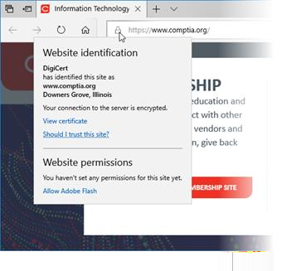
Cryptography for Authentication and Non-repudiation
Encryption allows subjects to identify and authenticate themselves. The screenshot below shows a sample website and whether it contains a certificate:

Slide 40
Cryptography Supporting Confidentiality
Cryptography eliminates the need for messages to be stored or transferred over secure media.
Symmetric key is used for bulk encryption and is protected by public key cryptography.
Public key cryptography is only efficient with small amount of data.
Symmetric encryption makes key distribution difficult.
1
Hybrid Encryption

Slide 41
Cryptography Supporting Confidentiality
Private key encrypts the
symmetric key.
The key use is locked to a user account credential.
2
File Encryption

Slide 42
Cryptography Supporting Confidentiality
Digital certificate is used to distribute the public key to clients.
Digital envelopes or perfect
forward secrecy is used.
3
Transport Encryption

Slide 43
Cryptography Supporting Integrity and Resiliency
Integrity
Resiliency
Cryptography is used to verify the authenticity and integrity of control messages.
It refers to validating messages using hash functions and authentication.
Obfuscation
It makes something hard to understand.
Encryption performs this function, but it is very hard to secure an embedded key.
It is a White-Box cryptography technique.

Slide 44




Cryptographic Performance Limitations
The following are the limitations of cryptographic performance:
Speed: The amount of data or number of operations performed per second is less.
Time/latency: There is delay in completing an operation.
Size: Key size increases security but it also increases CPU or memory requirements.
Computational overhead: Complexity of cryptographic implementation or cipher is
more.

Slide 45
Cryptographic Performance Limitations
The following are the limitations in terms of resource-constrained environments:
Low Power Devices
Low Latency
Battery powered systems
Contactless smart cards
Delay-sensitive communications and protocols

Slide 46

Cryptographic Performance Limitations
The following are the limitations in terms of entropy:
Weak ciphers and weak keys
Reduced order due to Checksums and ciphertext
Weak implementations
Weak randomness

Slide 47

Cryptographic Performance Limitations
The following are the limitations in terms of predictability and use:
Nonce
Initialization Vector (IV)
Salt

Slide 48
Key Takeaways
Cryptography is the skill of encrypting data in order to make it secure.
Hashing algorithms are simplest cryptographic algorithms. Using plain text with variable length, it generate, fixed length output commonly known as hash string.
Message integrity and authentication are not provided by symmetric algorithms.
Cryptography eliminates the need for messages to be stored
or transferred over secure media.

Slide 50
Implementing Public Key Infrastructure

Slide 51
Learning Objectives
By the end of this lesson, you will be able to:
Manage certificates and certificate authorities Compare the various types of certificates
Implement Public Key Infrastructure (PKI) management
Illustrate the features of Certificate Revocation List (CRL)

Slide 52
Manage Certificates and Certificate Authorities

Slide 53
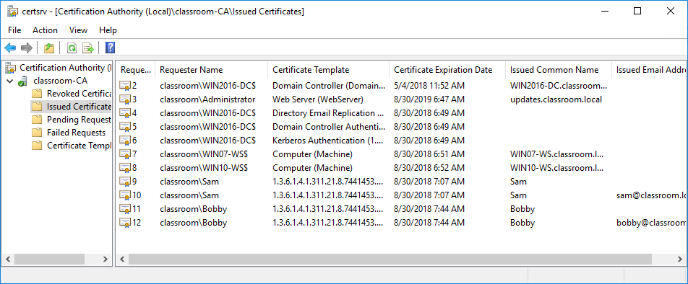
Certificate Authorities
The Certificate Authority (CA) is the organization responsible for issuing and guaranteeing certificates.
List of Issued Certificates
Certificate services are included in the majority of network operating systems, including Windows Server. However, for public or business-to-business communications, Sectigo or Comodo, GoDaddy, and GlobalSign are recommended.

Slide 54
Functions Performed by a CA
A CA performs the following functions:
Provide a range of certificate services that are beneficial to the CA's community of users
Ascertain the validity of certificates and the identity of those requesting them
Build user, government, and regulatory authority trust in the CA, as well as enterprise trust, such as financial institutions
Manage the servers (repositories) on which the certificates are stored and administered
Manage the lifecycle of keys and certificates, including revoking invalid certificates

Slide 55
PKI Trust Models
PKI trust models lay down the hierarchies to be followed by CAs. However, there is not one single hierarchy for all PKIs.
Hierarchical
(Intermediate CA)
CA Solitary
1
2

Slide 56
PKI Trust Models: CA Solitary
Features of this model:
The users trust only those issued by that CA.
A single CA issues
certificates to users.
Disadvantage: The single CA server is extremely vulnerable. If this key is compromised, the PKI will collapse.

Slide 57
PKI Trust Models: Hierarchical CA
A single CA (referred to as the root) issues certificates to several
intermediate CAs.
The intermediate CAs certify the subjects (leaf or end entities).
Features of this model:
The establishment of multiple intermediate CAs with distinct certificate policies allows the users to understand what a particular certificate is intended for.
Along the certification path, each leaf certificate can be traced back to the root CA. This is also known as certificate chaining or establishing a chain of trust.

Slide 58
PKI Trust Models: Hierarchical CA
01
The certificate for the root is self-signed. If the root system is compromised or damaged, the entire structure collapses.
Disadvantages of this model:
02
There is a lack of cross-certification, that is, the ability to trust the CA of another organization.

Slide 59


Online vs. Offline Certification Authorities
CAs can be either online or offline authorities.
An online CA accepts and processes certificate signing requests, publishes certificate revocation lists, and performs other certificate management functions.
Due to the high risk associated with compromising the root CA, a secure configuration requires that the root CA be configured as an offline CA.

Slide 60

Registration Process
Registration is the process by which end users establish a relationship with the CA and gain the ability to request certificates. It performs the following functions:
01
Authorizes user and establishes their identity
Conducts a variety of tests to verify the
authentication of a subject
02
03
Issues certificates only to legitimate users

Slide 61

Certificate Signing Request (CSR)
The Certificate Signing Request (CSR) is a Base64 ASCII file that contains the data that the subject wishes to include in the certificate, in addition to the subject's public key.
The steps in the CSR process are listed below:
01
Examines and verifies the information in the certificate
Delegates the registration function to one or more Registration Authorities (RAs) if required
02
Approves the request and sends the signed certificate to the subject
03

Slide 62
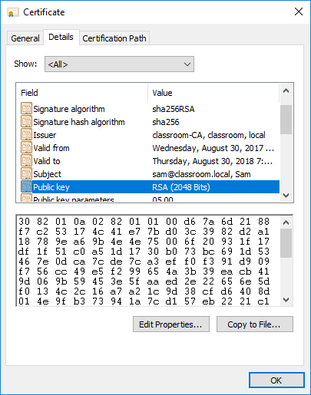
Digital Certificates
A digital certificate is essentially a container for the public key of a subject.
Contains information on the subject and the issuer or guarantor of the certificate
01
Digitally signed to demonstrate that it was issued by a particular CA to the subject
02
Digital Certificate Standards:
X.509 Public Key Infrastructure (PKIX)
PKCS (Public Key Cryptography Standards)
Sample Certificate

Slide 63
Certificate Attributes
Field | Usage
Serial Number | It is a number uniquely identifying the certificate within the domain of its CA.
Signature Algorithm | It is the algorithm used by the CA to sign the certificate.
Issuer | It is the name of the CA.
Valid From/To | It gives the date and time during which the certificate is valid.
Subject | It contains the name of the certificate holder, expressed as a distinguished name (DN). Within this, the Common Name (CN) part should usually match either the Fully Qualified Domain Name (FQDN) of the server or a user email address.
Public Key | It indicates the public key and algorithm used by the certificate holder.
Extensions | V3 certificates can be defined with extended attributes, such as friendly subject or issuer names, contact email addresses, and intended key usage.
Subject Alternative Name (SAN) | This extension field is the preferred mechanism to identify the DNS name(s) by which a host is identified.
Image Source: https://datatracker.ietf.org/doc/html/rfc5280

Slide 64


Subject Name Attributes
The following are the attributes of the subject name:
Common Name (CN)
Subject Alternative Name (SAN)
It refers to a legacy method of recording Fully Qualified Domain Name (FQDN)
They are structured identifiers
It is deprecated by standards
They list multiple host or subdomains
It is still used in many implementations
They use wildcard subdomain

Slide 65
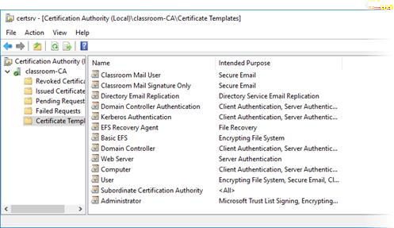
Configuring Certificate Types
The following indicates the factors that affect the configuration of various certificate types:
Certificate policies and templates
Key usage Extended key usage or
Enhanced key usage
Critical or non-critical
Certificate Location and Attributes

Slide 66
Types of Web Server Certificates
A server certificate verifies the identity of e-commerce websites or any other type of website where users submit sensitive data.
Domain Validation (DV)
Extended Validation (EV)
This establishes the ownership of a specific domain.
This process verifies the subject's legal identity and control over the domain or software being signed.
The CA or Browser forum is responsible for maintaining EV standards (cabforum.org)
A wildcard domain cannot be issued an EV
certificate.
It is done by responding to an email sent to the domain's authorized contact or by adding a text record to the domain.
This process is extremely susceptible to compromise.

Slide 67
Types of Other Certificates
There are numerous additional certificate types, each with a distinct purpose.
Certificates for Machines or Computers
Physical servers and Networking devices with FQDN
Allows access to network resources
Certificates for email or user
Sign and encrypt email messages
Varies based on the type of login credentials
Certificates for code signing
Validates publisher name
Root certificate
Single self-signed root certificate that offers certificate to others
Self-signed certificate
Deploy to any machine, web server, or program code

Slide 68
Implement PKI Management

Slide 69

Certificate and Key Management
Key management refers to the operational considerations for the various stages in a key's life cycle.
A key's life cycle involves the following stages:
Key generation
Expiration and renewal
Certificate generation
Revocation
Storage
Key management can be centralized or decentralized.

Slide 70

Key Recovery and Escrow
Private key of a root CA must be subjected to the highest possible access controls on a technical and procedural level.
Critical keys are subjected to M-of-N control.
Out of the N administrators permitted to access the system, M must be present to grant access.
Keys can be backed up to protect against data loss.
Escrow backup is use for recovery.

Slide 71



Certificate Renewal and Expiration
Certificates are issued with a limited duration, as set by the CA policy for the certificate type.
Certificate renewal
Certificate expiration
Once the key expires, it is then no longer
available.
New key is generated if the old key is feared to be compromised.
A key can either be archived or destroyed.
A key stored on hardware can be destroyed by a specified erase procedure.
During renewal, one can use the existing key or generate a new key.

Slide 72
Certificate Revocation and Suspension
A certificate may be revoked or suspended.
A revoked certificate is no longer valid and cannot be reinstated.
A suspended certificate can be re-enabled.

Slide 73
Reason Codes
The reason for revoking or suspending a certificate is coded under choices, such as:
Unspecified
Key Compromise
Superseded
Cessation of Operation

Slide 74


Certificate Revocation List (CRL)
CRL is a mechanism for informing users whether a certificate is valid, revoked, or suspended.
To follow this, the CA will:
Maintain a list of recoverable certificates
Conduct browser CRL checking

Slide 75
Online Certificate Status Protocol Responders
The following are the online certificate status protocol responders:
Online Certificate Status Protocol (OCSP)
OCSP Stapling
It is referred to as an OCSP responder.
Rather than returning a whole CRL, it just communicates the status of the requested certificate.
It resolves the issues by having the SSL or TLS web server periodically obtain a time- stamped OCSP response from the CA.

Slide 76


Online Certificate Status Protocol Responders
Certificate pinning are the techniques which ensure that when a client inspects a certificate,
they inspect the proper one.
Certificate pinning offers defense against man-in-the-middle attacks on chain of trust.
This is achieved by one or more public keys to an HTTP browser via an HTTP header, which is referred to as HTTP Public Key Pinning (HPKP).

Slide 77

Certificate Formats
There are various formats for encoding a certificate as a digital file for exchange between different systems.
Distinguished Encoding Rules (DER)
01
05
.P7B format
Privacy-Enhanced Electronic Mail (PEM)
02
04
.P12 format
03
File extensions: .DER, .PEM,
.CRT, .CER etc

Slide 78
OpenSSL Commands
The following represents a few operations that can be accomplished using
OpenSSL commands.
Converting certificate formats
Requesting certificate
01
02
03
04
Generating key pair and CA root certificate
Viewing and verifying certificates

Slide 79

Troubleshooting Certificate Issues
When dealing with certificate issues, the most common issue is a client rejecting a server certificate. The following are the steps taken to deal with certificate issues:
Check the expiry and status if it’s an existing certificate
Verify the key usage settings and requirements if it is new certificate
Verify the certificate chain of trust or root certificates
Verify the subject's name
Confirm the time and date settings
Additionally, the user must audit certificate infrastructure from a security standpoint to
ensure that only valid certificates are issued and trusted.

Slide 80
Key Takeaways
The Certificate Authority (CA) is the organization responsible for
issuing and guaranteeing certificates.
PKI trust models lays down the hierarchies to be followed by CAs.
Key management refers to the operational considerations for the various stages in a key's life cycle.
Certificate Revocation List (CRL) is a mechanism for informing users whether a certificate is valid, revoked, or suspended.

Slide 82
Implementing Authentication Controls

Slide 83
Learning Objectives
By the end of this lesson, you will be able to:
Illustrate authentication design concepts Implement knowledge-based authentication
Outline authentication technologies
Analyze biometrics authentication concepts

Slide 84
Summarize Authentication Design Concepts

Slide 85
Identification vs. Authentication
Identification
Authentication
Identification is the process used for performing identity proofing and creating a user account.
Authentication is the process that proves that the right user or the owner is accessing the user account.

Slide 86
Access Control System
An access control system refers to the technical controls that estimates the interaction of subjects with objects.
Subjects
Objects
Subject is a user, device, process of software, or any other content that can request and obtain access to resources.
Objects refer to resources such as files, databases, networks, servers, etc.

Slide 87
Identity and Access Management
An IAM system is described in terms of four main processes:
Identification
Associating a valid subject with a computer or network account
Accounting
Auditing the use of account
Authentication Providing credentials to operate the account
IAAA
Authorization
Assigning rights, permissions, or privileges to the account

Slide 88
Authentication Factors
Multi-factor authentication considers the following factors:
Something you
know
Something you
have
Something you do
Knowledge factor
Password
Personal Identification Number (PIN)
Swipe pattern
Challenge questions or password reset
Ownership factor
Hardware tokens and fobs
Biometric factor

Slide 89
Authentication Design
Authentication design is the process of selecting a technology that fulfils the requirements for confidentiality, integrity, and availability.
Confidentiality
Ensures that the credentials are secure
02
Integrity
Ensures that the
authentication mechanism is reliable and not easy for threat actors to bypass
Availability
Ensures that the time taken to authenticate does not impede workflows and is easy enough for users to operate
01
03

Slide 90
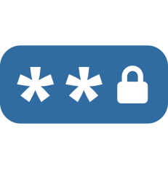


Single-Factor Authentication
Single-factor authentication can be easily compromised under following conditions:
If a password is written
down or shared
If a smart card is lost or stolen
If a biometric system is subjected to high error rates or spoofing

Slide 91
Multi-Factor Authentication
Multi-factor authentication combines the use of more than one type of knowledge, ownership, and biometric factor for authentication. The types are:
Two-Factor Authentication
Three-Factor Authentication
Two-Factor Authentication (2FA) combines either an ownership-based smart card or biometric identifier with something user knows.
Three-factor authentication combines all three technologies or incorporates an additional attribute such as location.

Slide 92


Authentication Attributes
Authentication attributes are non-unique factors that can be used for secondary or continuous authentication or access control mechanism. The following are the types of authentication attributes:
Geographic location of user
Behavioral characteristics of user
Somewhere users are
Something users can do

Slide 93


Authentication Attributes
Behavioral-based authentication and authorization with specific emphasis on user’s personality traits
Web of trust model
Something a user exhibits
Someone a user know

Slide 94
Implement Knowledge-Based Authentication

Slide 95
Authentication Provider
It is a software architecture and code that supports a mechanism for users to authenticate before starting the shell.
Knowledge-based authentication
Relies on cryptographic hashes
Single Sign-On (SSO) Authentication
Allows the user to authenticate once to a local device
Types of authentication providers
Windows Authentication
Involves a complex architecture of components
Linux Authentication
Stores local user account names in /etc/passwd

Slide 96

Windows Authentication
Typical scenarios of windows authentication:
Windows local sign-in
LSA compares the submitted credentials with the SAM database.
Windows remote sign-in
It is used when the user's device is not connected to the local network.
Windows network sign-in
LSA can pass authentication credentials to network service.

Slide 97

Linux Authentication
In Linux authentication, the user logs into the local interactive shell and the password is compared to the hash stored in /etc /shadow directory.
PAM is a software package that is used to enable different authentication providers. For example: Smart card login

Slide 98
Kerberos Authentication
Kerberos is a single sign-on network authentication and authorization protocol implemented by Microsoft's Active Directory (AD) service.
Client and application server depend on Key Distribution Center (KDC) for
their identity. The two services present in KDC are:
Authentication Service
Ticket-Granting Service

Slide 99
Authentication Service
The following steps are used by Authentication Service to authenticate user logon requests:
Send a request to the authentication service (AS) by the client to request a Ticket Granting Ticket.
Authenticate with
a KDC server
Step 1
Step 2
Step 3
Implement as a
domain controller

Slide 100


Authentication Service
If the request is valid, the AS responds with the following data:
Ticket Granting Ticket (TGT)
This contains information about the client, a timestamp, and validity period.
TGS Session Key
This is used for communications between the client and the Ticket Granting Service (TGS).

Slide 101



Kerberos Authentication
The diagram below shows an authentication service.
KDC
(Authentication Service)
Logon
Request
User: user1 Pass: ******
Timestamp:2020-03-01
Ticket Granting Ticket
Principal
Application Server

Slide 102



Kerberos Authorization
The diagram below shows a ticket granting system.
Ticket Granting Ticket
User: user1 Pass: ******
Timestamp:2020-03-01
KDC
(Ticket Granting Service)
Service Ticket
User: user1 Pass: ******
Timestamp:2020-03-01
1. Service Request
Service Ticket
User: user1 Pass: ******
Timestamp:2020-03-01
Application Server
2. Presents Service Ticket
Principal
3. Mutual Authentication (optional)
4. Data Transfer

Slide 103
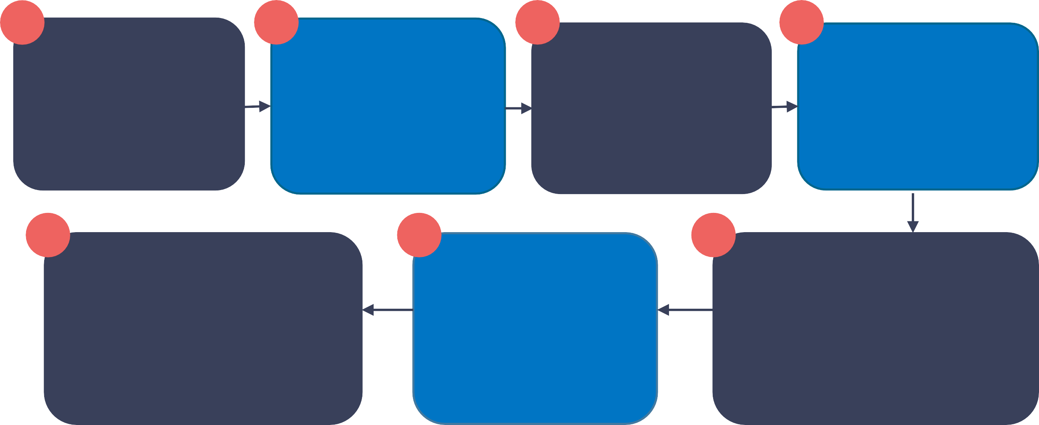
Kerberos Authorization
Presuming that the user entered the correct password, the client can decrypt the Ticket Granting Service (TGS) session key but not the TGT.
2 3 4
1
The client sends a copy of its TGT and the name of the application server to TGS.
The TGS service sends service session key and service ticket.
The client forwards service ticket that cannot be decrypted to application.
Client requests a service ticket to access the domain
7
6
5
The server now responds to client requests (assuming they conform to the server's access control list).
The application server responds to the client with the timestamp used.
The application server decrypts the service ticket and gets the service session.

Slide 104
PAP, CHAP, and MS-CHAP Authentication
The authentication protocol is developed to work with remote access protocols, where the connection is established through a serial link or a Virtual Private Network (VPN):
(PAP)
Password Authentication Protocol (PAP) is a method developed as part of the Point- to-Point Protocol (PPP) for the transmission
of TCP/IP data over a serial or dial-up connection.
CHAP
Challenge Handshake Authentication Protocol (CHAP) was developed as part of PPP to authenticate users through remote links.

Slide 105



PAP, CHAP, and MS-CHAP Authentication
CHAP relies on an encrypted challenge in a system called a three-way handshake that includes:
Verification
The server performs its own hash using the password hash stored for the client
Challenge
The server challenges and sends out random messages to the client.
Response
The client responds with the hash value calculated from the challenge message sent by the server and the client password.

Slide 106
PAP, CHAP, and MS-CHAP Authentication
MS-CHAPv2 is Microsoft's implementation of CHAP.
MS-CHAPv2 uses vulnerable NTLM hashes
Without secure connection tunnel protection, MS-CHAP should not be implemented to encrypt passed credentials.

Slide 107
Password Attacks
It is recommended to always use strong passwords that act as the best defence mechanism against password crackers.
Types of password attacks include:
Password Spraying
Offline Attacks
Password spraying allows the attacker to look for more than one passwords that are common.
An offline attack indicates that attacker has access to a database of password hashes.

Slide 108
Password Attacks
Types of password attacks include:
Plaintext or Unencrypted Attacks
Online Attacks
A plaintext or unencrypted attack exploits password storage or a network authentication
protocol that does not use encryption.
An online password attack is where the threat actor interacts with the authentication service.

Slide 109


Brute Force and Dictionary Attacks
Some password attacks exploit the weak credentials selected by users. Others can exploit vulnerabilities in the storage mechanism.
Brute-Force Attack
A brute force attack attempts to output all possible combinations in the space to match the captured hash and guess the plaintext that generated it.
Brute force attacks are distributed across multiple hardware components (such as a bunch of high-end graphics cards) and can successfully
crack longer passwords.

Slide 110
Brute Force and Dictionary Attacks
Dictionary and Rainbow Table Attacks
Dictionary attacks can be used when it is possible to guess possible
values from plain text (such as non-complex passwords).
Rainbow table attacks refine the dictionary approach.
The attacker uses a pre-computed lookup table of all possible
passwords and their matching hashes.
Using salt means hash chains cannot be pre-computed.

Slide 111

Brute Force and Dictionary Attacks
Hybrid Attack
A hybrid password attack uses a combination of dictionary and brute-force
attacks.
The password cracking algorithm tests dictionary words and names in
combination with a mask that limits the number of variations to test for; like adding
numeric prefixes and or suffixes.

Slide 112

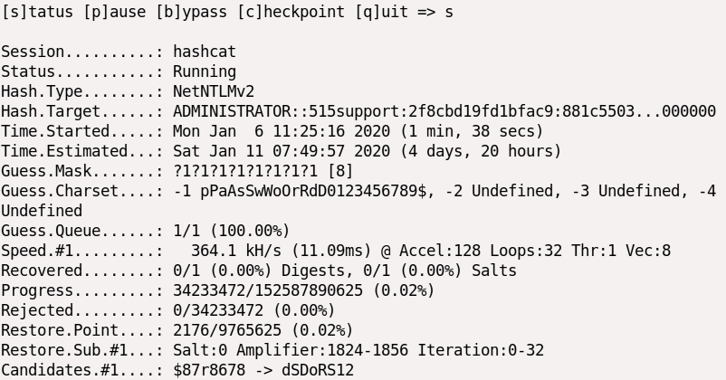
Password Crackers
Password crackers are application programs that are used to retrieve unknown passwords of a system.
This example is running on a VM, so the recovery rate is very low:

Slide 113
Password Crackers
Although there are some Windows tools, like the infamous Cain and L0phtcrack
(l0phtcrack.com) tools, most password crackers run primarily on Linux.
For example: Hashcat (hashcat.net/hashcat) tool runs using the following general syntax:
hashcat -m HashType -a AttackMode -o OutputFile

Slide 114
Password Crackers
The input file should contain hashes of the same type using the specified format.
Hashcat can be used with a single word list (dictionary mode -a 0) or multiple word lists (combinator mode -a 1).
Mode -a 3 performs a brute-force attack, but this can be combined with
a mask for each character position.

Slide 115

Authentication Management
Users often use poor credential management practices that are difficult to control, such as using the same password for company networks and consumer websites.
Password authentication management solutions mitigate this risk by using devices or services as credential storage agents.

Slide 116
Authentication Management
Password managers can be implemented with a hardware token or as a software app using:
Near Field Communications (NFC) or Bluetooth
Password key
Password vault

Slide 117
Implement Authentication Technologies

Slide 118
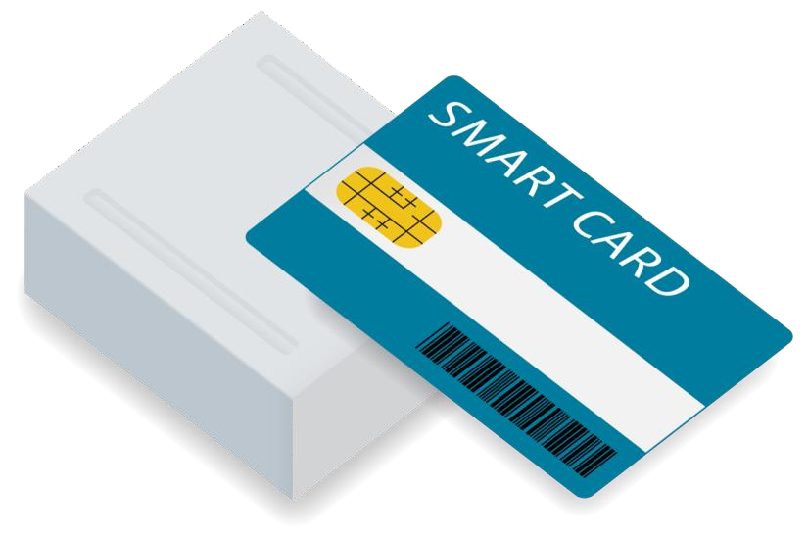
Smart Card Authentication
Smart card authentication uses a physical card to verify a user.
It provides:
Kerberos-based smart card logon
Card readers
Card stores user’s private key and certificate
Protection by a PIN

Slide 119

Key Management Devices
Some of the examples of key management devices include:
Provision keys with risk of insider threat reduced
Smart cards and USB keys
Hardware Security Module (HSM)
Trusted Platform Module
(TPM)

Slide 120

Hardware Security Module
Hardware Security Module (HSM) cryptographically secures the pseudorandom number generator (CSPRNG). They provide:
Provision keys to devices across the network
Key archive and escrow
Reduced attack surface and tamper-evident
Plug-in card and network rack form factors

Slide 121

Extensible Authentication Protocol and IEEE 802.1X
It authenticates users at network access devices, such as:
Wireless networks
Switched networks
Virtual private networks

Slide 122
Extensible Authentication Protocol and IEEE 802.1X
Extensible Authentication Protocol (EAP)
IEEE 802.1X Port-based Network Access Control
Supports multiple authentication implementations
Issues certificates and smart cards
Uses supplicant
Provides Network access server (NAS)

Slide 123







Remote Authentication Dial-In User Service
The working of Dial-in-User Service is shown in the below screenshot:
Network Access Point (RADIUS Client)
The RADIUS server and client are pre-configured with the same shared secret
Supplicant
1
2
The supplicant connects to the network
RADIUS AAA
Server
###
###
The NAP enables EAPoL and instructs the supplicant to authenticate
EAPoL
EAPoL
3
Shared Secret
RADIUS
###
4
The supplicant transmits EAP data
5
The NAP encrypts the EAP data using the shared secret and forwards it to the RADIUS server
### 6
The RAIDUS
server decrypts the packet using the shared secret and validates the
credential
RADIUS AAA
Server
RADIUS
###
###
The NAP decrypts the Access-Accept and opens the network channel for
regular traffic
8
7
The RADIUS server issues an Access-Accept
Supplicant
Network Access Point (RADIUS Client)

Slide 124

Remote Authentication Dial-In User Service
Features of Remote Authentication Dial-in User Service:
The Remote Authentication Dial-in User Service (RADIUS)
standard is published as an Internet standard.
The NAS device (RADIUS client) is configured with the IP address of the RADIUS server and with a shared secret.
The NAS device configuration allows the client to authenticate to the server.
The client is the access device (switch, access point, or VPN gateway), not the user's PC or laptop.

Slide 125
Remote Authentication Dial-In User Service
A generic radius authentication workflow proceeds as follows:
1
2
3
4
The user's device (the supplicant) makes a connection to the NAS appliance.
The NAS prompts the user for authentication credentials.
The supplicant submits the credentials as EAPoL data.
The AAA server decrypts the Access-Request using the shared secret.
6
5
At the end of this exchange, if the supplicant is authenticated, the AAA server responds with an Access-Accept packet.
With EAP, there will be an exchange of Access-Challenge and Access-Request Packets.

Slide 126

Terminal Access Controller Access-Control System
This allows network administrators to be allocated specific privileges on each switch router, access point, and firewall.
1
Uses TCP communication (over port 49)
2
Encrypts all the data in TACACS+ packets
3
Executes authentication, authorization, and
accounting functions

Slide 127
Token Keys
Token keys help address the management issues that arise while using digital certificates required by smart card authentication.
Some of the popular token key methods are:
One-Time Password RSA SecurID
Static code
Fast Identity Online and Universal 2nd Factor

Slide 128

Open Authentication (OATH)
The Initiative for Open Authentication (OATH) is an industry body established with the aim of developing an open and strong authentication framework.
OATH has developed two algorithms for implementing one-time passwords (OTPs):
HMAC-Based One- Time Password Algorithm (HOTP)
Time-Based One-Time Password Algorithm (TOTP)
1
2

Slide 129
Open Authentication (OATH)
HMAC-Based One-time Password Algorithm (HOTP)
Time-Based One-Time Password Algorithm (TOTP)
It is an algorithm for token-based authentication.
The authentication server and client token are configured with the same shared secret.
It is a refinement of the HOTP.
In TOTP, the HMAC is built from the shared secret plus a value derived from the device's and server's local timestamps.

Slide 130

2-Step Verification
Two-step verification or out-of-band mechanisms generate a software token on a server and send it to a resource assumed to be safely controlled by the user. The token can be transmitted to the device in the following ways:
Short Message Service (SMS) The code is sent as a text to the registered phone number.
Phone Call
The code is delivered as an
automated voice call to the registered phone number.
Email
The code is sent to a registered
email account.
Push Notification
The code is sent to a registered authenticator app on the PC or smartphone.

Slide 131
Summarize Biometrics Authentication Concepts

Slide 132

Biometric Authentication
Enrollment is the first step in setting up biometric authentication. Enrollment is done by scanning the selected biometric information.
Steps used in scanning process:
1
2
The sensor module obtains biometric samples from the target.
The feature extraction module records features that uniquely identify the target in the sample.

Slide 133
Biometric Authentication
Patterns used to identify people biometrically are :
Physical
Behavioral
Fingerprint
Voice signature
Eye and facial recognition
Typing pattern matching

Slide 134
Efficacy Rates And Considerations
Mechanisms used to evaluate efficacy rates of biometric authentication are:
False Rejection Rate (FRR) or Type I Error
False Acceptance Rate (FAR) or Type II Error
Efficacy Rates
Crossover Error Rate (CER)
Throughput (speed)

Slide 135
Efficacy Rates And Considerations
Factors to be considered when implementing biometric authentication are:
Cost of implementation
Privacy concerns
Accessibility concerns

Slide 136
Fingerprint Recognition
Fingerprint recognition is the most widely used biometric authentication method.
The technology required to scan and register fingerprints is
relatively inexpensive and the process is very simple.
The fingerprint sensor is implemented as a small capacitive cell that
can detect fingerprint data.
This technology is non-intrusive.
The technology is relatively simple to use, although moisture or dust can prevent readings.

Slide 137

Facial Recognition
Facial recognition records multiple indicators of the face.
The initial pattern should be recorded under optimal lighting conditions.
1
This technology is closely related to law enforcement and is more likely to cause inconvenience to users with personal privacy concerns.
2
3
Facial recognition suffers from a relatively high rate of
false acceptance, rejection, and can be easily deceived.

Slide 138
Facial Recognition
The limitations of facial recognition can be countered by scanning more detailed features of the eye. This includes:
Retinal Scan
Iris Scan
An infrared light is passed into the eye
to identify the pattern of blood vessels.
This scan uses near-infrared images to match patterns on the surface of the eye. It is not as invasive as the retinal scan, and it is faster.
The arrangement of these blood vessels is very complicated, except for certain diseases or injuries, usually unchanged from birth to death.
The accuracy of an iris scanner is like that of a retinal scan, but it is much less likely to be affected by disease.

Slide 139
Behavioral Technologies
Templates are created by analyzing behaviors, such as typing, writing a signature, or walking or moving.
Gait analysis
It produces a template from human movement.
Types of Behavioral Technologies
Signature recognition
Signatures are relatively easy to duplicate, but it is more difficult to forge the actual signature process.
Typing
It matches the speed and pattern of the user’s input

Slide 140
Biometric and Behavioral Technologies
Certain biometric and behavioral technologies can be used for purposes other than logon authentication:
Biometric Identification
Continuous Authentication
Biometric identification refers to matching people to a database, rather than performing identity verification on themselves.
Continuous authentication verifies the logged in user is still operating the device using continuous identity verification.

Slide 141
Key Takeaways
An access control system refers to the technical controls that
estimates the interaction of subjects with objects.
Authentication design is the process of selecting a technology that fulfils the requirements for confidentiality, integrity, and availability.
Kerberos is a single sign-on network authentication and authorization protocol.
When a user chooses a password, the password is converted to a hash using a cryptographic function like MD5 or SHA.

Slide 143
Implementing Identity and Account Management Controls

Slide 144
Learning Objectives
By the end of this lesson, you will be able to:
Implement Identity and Account Control types.
List the different account policies.
Analyze authorization solutions.
Illustrate the importance of personnel policies.

Slide 145
Identity Management Controls

Slide 146
Identity Management Controls
The network administrator ensures the integrity of the server hosting the accounts, while each user is responsible for protecting the credentials to authenticate and use the account.
This is done using cryptographic materials that include:
Certificates and Smart Cards
Public Key Infrastructure (PKI) allows the management of digital identities, where as Certificate Authority (CA) issues certificates to validated subjects (users and servers).
The certificate contains the subject's public key and is signed by the CA's public key.
It can be stored on the computer, either in the file system or in a Trusted Platform
Module (TPM) chip.

Slide 147
Identity Management Controls
Tokens
Identity Providers
The identity provider is the service that provisions the user account and processes authentication requests.
Authorization services can be operated locally.
It helps in federated identity management
In a single sign-on system, the user authenticates to an Identity Provider (IdP) and receives a cryptographic token.
The user can present that token to compatible applications as a proof of being authenticated and receive authorizations from the application.

Slide 148



Background Check and Onboarding Policies
Identity and Access Management (IAM) involves both IT procedures and technologies, in addition to Human Resources (HR) policies.
Personnel management policies are applied in three phases:
Termination or separation (firing or retiring)
Recruitment (hiring)
Operation (working)

Slide 149


Background Check
A background check evaluates whether a person is authentic and not concealing any criminal activity,
bankruptcy, or risky connections.
Employees working in high confident.iality environments are under strict observations.
Few background checks are conducted internally and others are
executed by an external third party.

Slide 150
Onboarding
Onboarding at the HR level is the process of welcoming a new employee to the organization.
Some of the other tasks and processes involved in onboarding are:
Secure transmission of credentials
Account
provisioning
Asset allocation
Training and policies

Slide 151

Non-Disclosure Agreement (NDA)
The terms and conditions of a Non-Disclosure Agreement (NDA) is incorporated within the employee contract. It goes as a separate document when needed.
Signing an NDA means the employee has agreed to not share any confidential information with any third party.

Slide 152
Personnel Policies for Privilege Management
HR and IT must collaborate to ensure effective privilege management.
These policies aim to ensure that the risk of insider threat is minimized. The different policies include:
Separation of Duties
Separation of duties is a means to check and balance the possibility that critical systems or procedures may be damaged by internal threats.
Standard Operating Procedures (SOPs) indicate that there is no excuse for employees for
not following protocol to perform these types of critical operations.
Shared authority indicates that users cannot take actions or enable changes on their own.

Slide 153
Personnel Policies for Privilege Management
Types of personnel policies used for privilege management are as follows:
Least Privilege
Job Rotation
Least privilege means that the user has sufficient privileges to do their job and nothing more.
Job rotation (or rotation of duties) means that only one person is not permitted to do the same job for a long time.
Mandatory Vacation
Mandatory vacation means that employees are forced to take their holiday,
In meantime, someone else fulfills their duties.

Slide 154
Offboarding Policies
Exit interviews (or offboarding) are used to ensure that employees depart from a company gracefully.
There are several processes that must be completed in terms of security:
Company assets
Recover mobile devices, keys, smart cards, and
USB media, among others
Account administration Disable the user account and its associated privileges
Personal assets
Purge corporate data and applications from employee- owned devices

Slide 155
Security Account Types and Credential Management
Operating systems, network appliances, and network directory components make use of some common account type as the foundation for their privilege management systems.
Different types of accounts available are:
Standard user
Administrative user
Security group
Service accounts

Slide 156



Credential Management Policies for Personnel
A password policy educates users on the proper use and maintenance of passwords.
A credential management policy should educate users on how to maintain the security of their authentication method, whether it is a password, smart card, or biometric ID.
Users must be able to identify phishing and pharming attempts in order to avoid entering sensitive information into an insecure form or spoofed website.
Guest account is a type of shared account that does not require a password.

Slide 157




Security Group-Based Privileges
The security group account concept simplifies and centralizes the administrative process of rights assignment.
Instead of directly assigning rights, the system administrator delegates them to security group accounts.
Access Control List (ACL)
Access Control List (ACL)
User
User
SID: 100
SID: 102
READ (Group)
READ & WRITE (Group)
User
User
User
User
3
SID: 100
1
Assigning permissions directly to user accounts does not scale well
SID: 101
2
SID: 101
SID: 102
Instead, user accounts can be made members of different security groups
The security group is given permission on the object ACL and the user account inherits the permissions from the group

Slide 158

Administrator or Root Accounts
Administrative or privileged accounts can install or remove apps and device drivers, change system-level settings, and access any object in the file system.
A default account is created by the operating system or an application when it is installed.

Slide 159

Administrator or Root Accounts
Generic Administrator Account Management has the following properties:
Superuser accounts directly contradict the principles of least privilege and separation of duties.
The default superuser account is restricted only for
disaster recovery operations.
The first user account created during setup has superuser permissions.
In Linux distributions, a password is usually set at the time of installation.

Slide 160
Administrator or Root Accounts
An operating system creates a default security program that should:
Replace with one or more named accounts with sufficient elevated privileges for a given job role
Create default security groups, with a default set of permissions
1
2

Slide 161
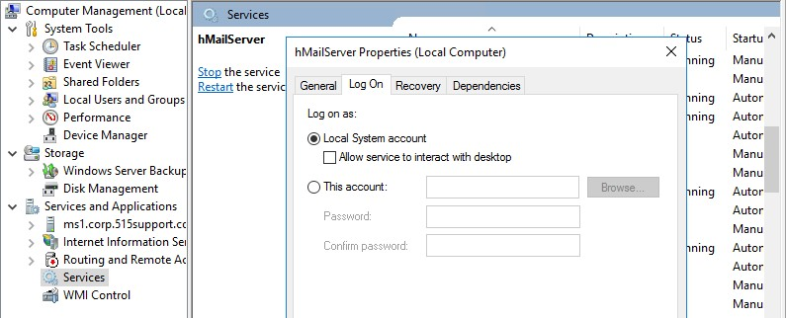
Service Accounts
Service accounts are used by scheduled processes and application server software like databases.

Slide 162
Service Accounts
Service accounts do not accept any user interactive logons but can be used to run processes and background services. This includes:
Local Service
This has the same privileges as the standard user account.
02
Network Service
It has the same privileges as the standard user account but can present the computer's account credentials when accessing network resources.
System
It has the most privileges of default Windows account.
01
03

Slide 163
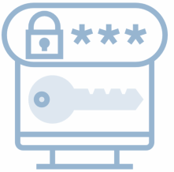


Shared or Device Accounts and Credentials
A A shared account is an account where multiple people know the password (or other authentication credentials).
Shared accounts might be configured with a default password.
Shared accounts violate the principle of non-repudiation and makes it difficult to establish an accurate audit trail.
Another major risk involves changing account passwords.

Slide 164
Shared or Device Accounts and Credentials
A shared account is one in which multiple people have access to it. The types of shared accounts are:
Default OS Accounts: Includes administrator and guest in Windows or root in Linux, or accounts added to default security groups
Credential Policies for Devices: Network appliances designed for enterprise use are unlikely to be restricted to a single default account. They will use TACACS+ to support individual accounts and role-based permissions.
Privileged Access Management: Enterprise privilege access management products provide a solution for storing these high-risk credentials somewhere other than a spreadsheet and for auditing elevated privileges generally.

Slide 165
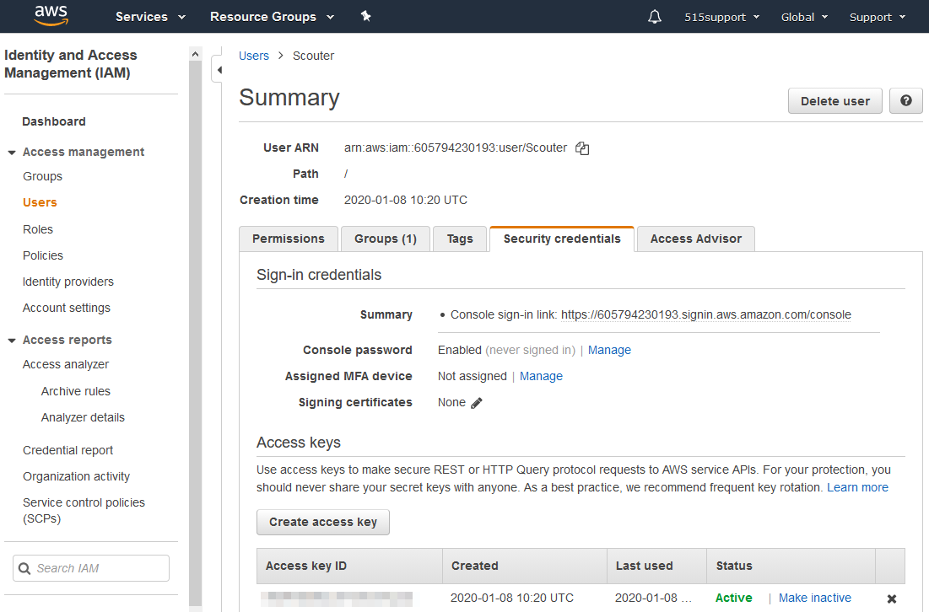
Secure Shell Keys and Third-Party Credentials
Secure Shell (SSH) is a widely used protocol for remote access.
It is used to manage devices and services.

Slide 166

Secure Shell Keys and Third-Party Credentials
SSH utilizes two distinct types of key pairs:
A host key pair that identifies an SSH server.
A user key pair that is used to authenticate a client with an SSH server.

Slide 167

Secure Shell Keys and Third-Party Credentials
There are vendor-provided SSH key management solutions. Users can configure servers and clients to validate identities using Public Key Infrastructure (PKI) and Certificate Authorities (CAs).
A third-party credential is used by organizations to administer a vendor service or cloud application.
Along with administrative logons, devices and services can be configured with a password or rudimentary cryptographic keys to connect hosts via SSH or an Application Programming Interface (API).

Slide 168
Implement Account Policies

Slide 169
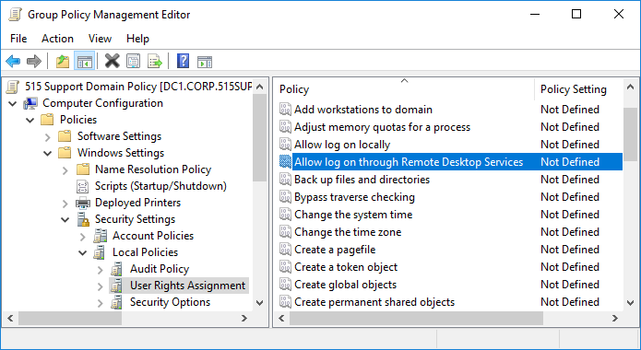
Account Attributes and Access Policies
Along with establishing user authentication, an account can be configured with attributes to serve as a user profile.

Slide 170
Account Attributes and Access Policies
Account Attributes
Access Policies
Each account can be assigned permissions over files and other network resources, as well as access policies or privileges over network host use and configuration.
Access policies define a user's ability to log on to a computer locally or remotely.
A Unique Security Identifier (SID), a name, and a credential that define a user account.
Each account has a profile associated with it.

Slide 171
Account Password Policy Settings
System-enforced account policies can help enforce credential management principles by stipulating requirements for user-selected passwords.
Password length
Password
complexity
Factors to be considered when setting an account password are:
Password reuse and history
Password aging

Slide 172
Account Password Policy Settings
Recent guidance issued by NIST deprecates some of the traditional elements of password policy.
It states that:
Aging policies should not be enforced
Complexity rules should not be enforced
Password hints should
not be used

Slide 173
Account Restrictions
Account restrictions can be used to make the task of compromising the user security system harder.
Location-Based Policies
A user or device can have a logical network location identified by an IP address, subnet, Virtual LAN (VLAN), or Organizational Unit (OU).
This can be used as an account restriction mechanism.

Slide 174

Location-Based Policies
The geographical location of a user or device can also be calculated using a geolocation mechanism.
Different types of geolocations include:
IP Address
These can be associated with a map location to varying degrees of accuracy based on information published by the registrant, including name, country, region, and city.
Location Services
These are methods used by the OS to calculate the device's geographical position.
1
2

Slide 175

Time-Based Restrictions
Time-based restrictions use three main types of policies:
Time day policy
Risk login policy
Time-based login policy

Slide 176
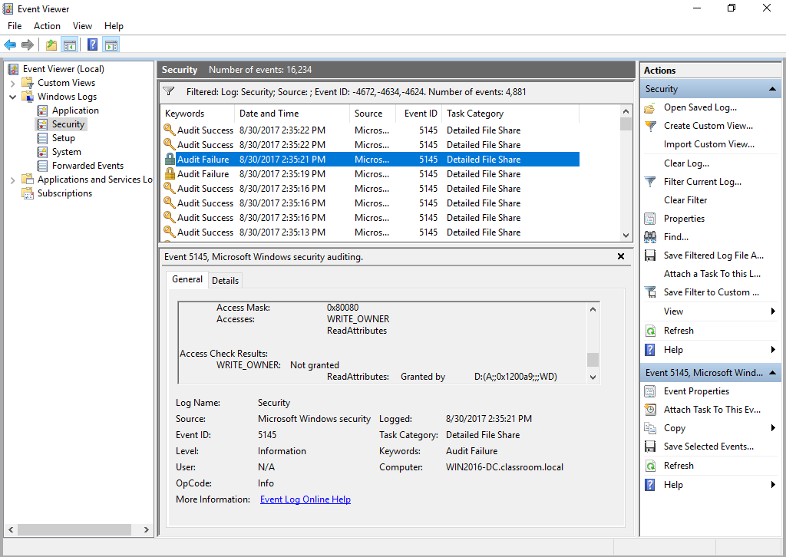
Account Audits
Accounting and auditing processes are used to determine whether an account has been compromised or is being used inappropriately.

Slide 177
Account Audits
To aid in the detection of account misuse, a security or audit log can be used to:
Track all user actions
Determine the existence of intrusions or attempted intrusions

Slide 178
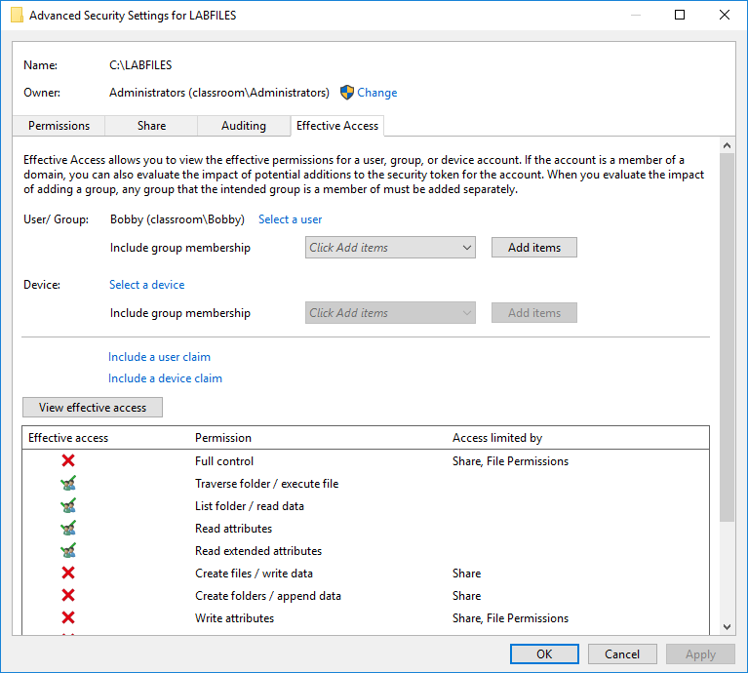
Account Permissions
Managing account permissions is a complex and time-consuming process where multiple users, groups, roles, and resources are involved.
The screenshot shows how to determine effective permissions for a shared folder.

Slide 179

Account Permissions
Improperly configured accounts can have two different types of impact:
1
Setting privileges that are too restrictive creates a large volume of support calls and reduces productivity
Granting too many privileges to users weakens the security of the system and increases the risk of malware infection and data breach
2

Slide 180
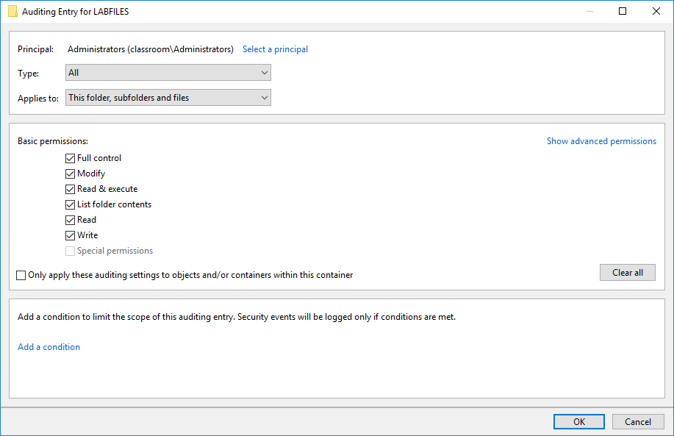
Usage Audits
Usage auditing refers to configuring the security log to record key indicators and then reviewing the logs for suspicious activity.
The screenshot below shows how to configure audit entries for a folder in Windows.

Slide 181

Usage Audits
For Active Directory, Microsoft has published audit policy recommendations for baseline requirements and networks with stronger security requirements.
Some typical recommendations include:
Account logon and management events
System security and integrity
01
02
Process creation
03
04
Audit policy
05
Object access

Slide 182

Account Lockout and Disablement
If account misuse is detected or suspected, the account can be manually disabled by setting an account property. This prevents the account from being used for login.
Account disablement refers to permanent prevention of login until an administrator manually re-enables the account.
Account disablement disables the account’s use as a login.
Deactivating the account does not result in the termination of existing sessions. To terminate a session, use the remote logoff command.

Slide 183




Account Lockout and Disablement
An account lockout refers to a state where login is prevented for a temporary period.
This might be done manually if a policy violation is detected, but there are several scenarios for
automatically applying a lockout, such as:
An incorrect password is entered repeatedly.
The account is set to expire.
When using time or location-based restrictions and the server periodically checks for user authenticity.
If the user does not have the appropriate permissions.

Slide 184
Implement Authorization Solutions

Slide 185
Discretionary and Role-Based Access Control
A critical aspect of developing a security system is determining how users obtain rights or permissions.
Access control schemes refer to the various models:
Discretionary Access Control (DAC)
Discretionary Access Control (DAC) is predicated on the resource owner's primacy.
Role-Based Access Control (RBAC)
Role-based Access Control (RBAC) enhances the DAC model's centralized control.
The owner of a file or service is the original creator, though ownership can be transferred to another user.
RBAC defines a set of organizational roles and assigns subjects to those roles.

Slide 186
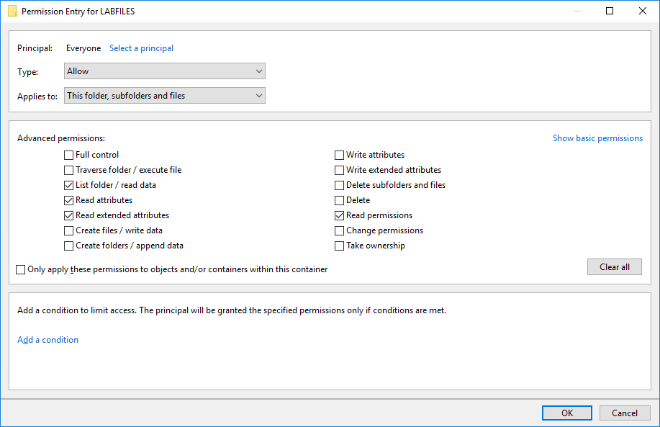
File System Security
Access Control List (ACL) and Access Control Entry (ACE)
The figure below shows how to configure an access control entry for a folder

Slide 187


Mandatory and Attribute-Based Access Control
The DAC and RBAC models create a risk of compromise for privileged accounts.
Mandatory Access Control (MAC)
MAC is an access control policy that is based on the concept of security clearance levels.
Rather than defining Access Control Lists (ACLs) for resources, each object and subject is assigned a clearance level, referred to as a label.

Slide 188


Mandatory and Attribute-Based Access Control
Attribute-Based Access Control (ABAC)
ABAC is the most granular type of access control model.
An ABAC system can make access decisions using a combination of subject and object attributes, as well as any context-sensitive or system-wide attributes.

Slide 189
Rule-Based Access Control
Rule-based access control is a term that can refer to any type of model access control, where the access control policy is determined by mandatory system rules rather than system users. It:
Monitors account or device behavior throughout a session
Controls Rule-Based Access
1
2

Slide 190
Rule-Based Access Control
Examples of rule-based access control:
Conditional Access
The User Account Control (UAC) and sudo restrictions on privileged accounts are examples of conditional access.
Privileged Access Management
A privileged account is one that can make significant configuration changes to a host, such as installing software or disabling a firewall or other security system.
These controls identify and document privileged accounts, giving visibility into their use,
and manage the credentials used to access them.

Slide 191
Directory Services
Directory services are critical for the functioning of most enterprise networks. They:
Deal with the confidentiality of information, integrity of the information, and DoS
02
Are used over the Internet (IM user directories, for instance)
Have the Common Name (CN) attribute of an X.509 digital certificate that is commonly configured as the FQDN
01
03

Slide 192







Federation and Attestation
An overview of the Federated Identity Management process can be seen below.
Service Provider (SP)
The SP and IdP have a pre-established trust relationship
The user starts a session with the SP
1
2
Identity
Provider (IdP)
User
3
The SP redirects the user to the IdP to authenticate
Redirect to IdP
The user authenticates to the IdP
4
Auth
5
The IdP issue claims token to the user
6
User
The user presents the claims token to the SP and is associated with a legitimate account and set of authorizations
Service Provider (SP)
Identity Provider (IdP)

Slide 193
Federation and Attestation
The concept of federation defines that the network accessibility should not be limited to a
well-defined group of employees, instead it should be extended to others as well due to
the following reasons:
In business, the company may need to share part of the
network with its partners, suppliers, and customers.
It is easier for companies to manage their employees' accounts internally compared to accounts created by suppliers or customers.
Federation means that the company trusts the accounts created
and managed by different networks.

Slide 194
Identity Providers and Attestation
In these models, the networks perform federated identity management.
The process is similar to Kerberos authorization and works as follows:
The user (principal) attempts to access a Service Provider (SP), or the Relying Party
(RP).
The principal authenticates with the identity provider and obtains an attestation of identity.
The principal presents the attestation to the service provider.
The service provider can now connect the authenticated principal to its own accounts database.

Slide 195


Federation and Attestation
Cloud versus On-Premises requirements:
Use of cloud services or shared resources with business partner networks, authentication and authorization design have more constraints and additional requirements.
Web applications might not support Kerberos, while third-party networks might not support direct federation with Active Directory or LDAP.

Slide 196
OAuth and OpenID Connect
Many public clouds use Application Programming Interfaces (APIs) based on Representational State Transfer (REST), rather than SOAP. They are also:
Called RESTful APIs
Better support for mobile apps

Slide 197

OAuth
Authentication and authorization for a RESTful API is often implemented using the Open Authorization (OAuth) protocol.
A user (resource owner) can grant a client an authorization to access some part of their account.
02
The client app or service must be registered with the authorization server.
01
03
A client in this context is an
app or consumer site.

Slide 198
OAuth
A single authorization server can manage multiple resource servers.
Registration also provides the client with an ID and a secret key.
The client app or service must be registered with the authorization server.
OAuth uses the JavaScript Object Notation (JSON) Web Token (JWT) format for claims data.

Slide 199

OpenID Connect
Open OIDC is an authentication protocol that can be implemented as a subset of OAuth flows with precisely defined token fields.

Slide 200
Importance of Personnel Policies

Slide 201
Conduct Policies
Operational policies include privilege or credential management, data handling, and incident response.
Other important security policies include:
Code of Conduct and Social Media Analysis
Acceptable Use Policy
Enforcing an Acceptable Use Policy (AUP) is very important for the safety of the organization and it protects organization from legal implications of employees misusing its equipment.
The code of conduct or rules of conduct set the expected professional standards.
Acceptable use guidelines must be reasonable and must not interfere with employees' core job responsibilities or privacy rights.

Slide 202
Conduct Policies
Use of Personally Owned Devices in the Workplace
Portable devices, such as smartphones, USB sticks, media players, and other devices pose a significant threat to data security, because they help in easy file copying.
Some companies may try to prevent employees from bringing these devices to the site.
Clean Desk Policy
A clean desk policy means that every employee's work area must be free from any documents.
It prevents unauthorized employees or guests in the workplace from obtaining confidential information.

Slide 203

User and Role-based Training
Untrained users are open to serious vulnerability, because they are vulnerable to social engineering and malware attacks, and can be careless when handling sensitive or confidential data.
Employees at all levels, including end users, technical staff, and management personnel should receive appropriate security awareness training.

Slide 204




User and Role-based Training
Some of the general topics that need to be covered under security awareness are as follows:
An overview of the organization's security policy and penalties for
violations
Procedure for incident identification and reporting
On-site security procedures, restrictions, and recommendations,
including security drills and guest escorting
Data processing, including document confidentiality, PII, backup, encryption, etc.

Slide 205



User and Role-based Training
Password and account management as well as security features
for PC and mobile devices
Awareness of social engineering and malware threats, including
phishing and website vulnerabilities
Usage of software such as browsers ,email clients,internet access safely and appropriately, including social media sites

Slide 206
Diversity of Training Techniques
It is necessary to frame security training in language that end users will respond to.
It is necessary to educate users about new or emerging threats, but this needs to be stated in language that users understand.
Using a diversity of training techniques helps improve engagement and retention.

Slide 207

Diversity of Training Techniques
Phishing Campaigns training event refers to sending simulated phishing messages to users.
Users that respond to the messages can be targeted for follow-up training.

Slide 208

Diversity of Training Techniques
Capture The Flag (CTF) is usually used in ethical hacker training programs and gamified competitions where the:
Flag represents either threat actor activity or a vulnerability, and the participant must use analysis and appropriate tools to discover it
Participants must complete a series of challenges within a virtualized computing environment to discover a flag
1
2

Slide 209
Diversity of Training Techniques
Computer-Based Training (CBT) allows a student to acquire skills and experience by completing various types of practical activities that include:
Simulations
Recreating system interfaces or using emulators for students to practice configuration tasks
Gamification elements
Boosting security awareness
Branching Scenarios Choosing the best solution to solve a cybersecurity incident or configuration problem

Slide 210
Key Takeaways
The network administrator ensures the integrity of the server hosting the accounts, while each user is responsible for protecting the credentials to authenticate and use the account.
HR and IT must collaborate to ensure effective privilege management. These policies aim to ensure that the risk of insider threat is minimized.
If account misuse is detected or suspected, the account can be manually disabled by setting an account property. This prevents the account from being used for login.
Operational policies include privilege or credential management, data handling, and incident response.

